Slide 1

Voice Lessons
from Nancy Dean
Activities by Dina Cooper

Slide 2

Tone #1
Consider:
“What a thrill—
My thumb instead of an onion.
The top quite gone
Except for a sort of a hinge
Of skin,
A flap like a hat,
dead white.
Then a red plush.”
--Sylvia Plath, “Cut: For Susan O’Neill” Roe”
Then a red plush
subjects writing across the curriculum.

Slide 3
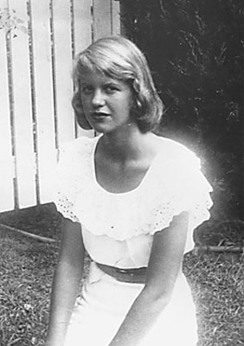
Discuss:
What is the poet’s attitude toward the cut? What words, images and details create the tone?
In the second stanza, Plath uses colors to
intensify the tone. The flap of skin is
dead white, the blood is a red plush.
What attitude toward the cut and by
implication, toward life itself, does this
reveal?

Slide 4
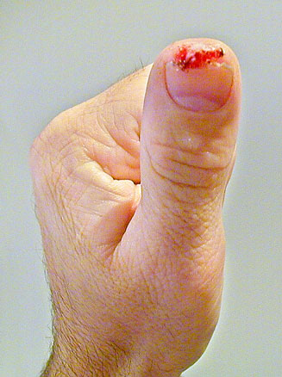
Response
1. The poet’s attitude toward the cut is ironic, stating one thing and meaning quite another. Through the trivialization of the cut, the poet creates a scene of such sharp detail that she renders the cut horrific. She calls the cut a thrill and compares her thumb to an onion, the top quite gone/Except for a sort of hinge/Of skin. Giving her thumb the same value as a slice of onion serves the opposite purpose: it affirms the value of her thumb and acknowledges the horror of the cut. The ironic tone works the same way with the image of the partially severed top of her thumb: a flap like a hat. Comparing the partially severed skin to a hat increases the horror of the cut by trivializing it through her imagery and detail.

Slide 5
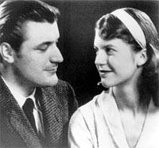
Response
2. Dead white modifies hat, and, by implication, flap and skin. White here is associated with death, dissolution and the pallor of corpses. It generalizes the cut and forces the reader to consider death. The red plush of the blood indicates a luxurious lushness, almost seductive. The attitude revealed here is a dual one: fear of death and attraction to it.

Slide 6

Tone #2
Consider:
Microphone feedback kept blaring out the speaker’s words, but I got the outline. Withdrawal of our troops from Vietnam. Recognition of Cuba. Immediate commutation of student loans. Until all these demands were met, the speaker said he considered himself in a state of unconditional war with the United States government.
I laughed out loud.
-- --Tobias Wolff, “Civilian”

Slide 7
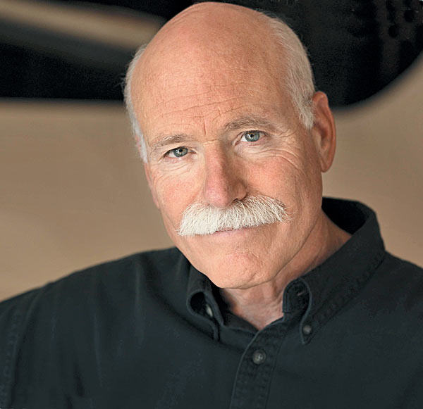
Discuss:
What is the attitude of the narrator toward the political speaker in this passage? How do you know?
2. How does the use of a short direct sentence at the end of the passage (I laughed out loud) contribute to the tone?

Slide 8
Response
1. The attitude of the narrator toward the political speaker is sardonic. The fact that the microphone feedback was blaring out the speaker’s words, but the narrator still got the outline indicates that it is not necessary to hear all of the speech to get the gist, that much of it is rant and rhetoric. The sentence fragments give the main ideas of the speech: slogans without substance. And the speaker’s declaration that he alone is in a state of unconditional war with the United States government makes the speaker look pretentious and ridiculous.

Slide 9
Response
2. The short, direct sentence at the end of the passage makes a mockery of the political speech and fixes the sardonic tone of the passage. Not only does the narrator laugh at the speech, he laughs out loud, a clear dismissal of the rhetoric and a public acknowledgement of his scorn.

Slide 10
Tone #3
Consider:
It’s his first exposure to Third World passion. He thought only Americans had informed political opinion—other people staged coups out of spite and misery. It’s an unwelcome revelation to him that a reasonably educated and rational man like Ro would die for things that he, Brent, has never heard of and would rather laugh about. Ro was tortured in jail. Franny has taken off her earphones. Electrodes, canes, freezing tanks. He leaves nothing out. Something’s gotten into Ro.
Dad looks sick. The meaning of Thanksgiving should not be so explicit.
-- Bharati Mukherjee, “Orbiting”

Slide 11

Discuss:
What is the narrator’s attitude toward
Brent (Dad)? Cite your evidence.
How does the syntax in this passage
help create the tone?

Slide 12
Response
1. The narrator’s attitude is disparaging but not condemnatory. Tone is established through diction, detail, imagery, and syntax. First, the narrator establishes Brent’s narrow-mindedness through diction and detail. He thinks only Americans [have] informed political opinion. He thinks other people [stage] coups out of spite and misery. He would rather laugh about the things that Ro would die for, and he believes the meaning of Thanksgiving should not be so explicit. Further, it is unwelcome news that he might be wrong.

Slide 13
Response
1. (continued) Brent’s prejudice is in sharp contrast to the images of Ro’s torture: electrodes, canes, freezing tanks. The simple concreteness of these images makes Brent’s opinions and laughter hollow. The tone is not completely disparaging, however. Since this is Brent’s first exposure to Third World passion and he looks sick after the encounter, there is some built-in forgiveness for his narrow-mindedness and some acceptance for his provincialism.

Slide 14
Response
2. Syntax helps create the tone through the author’s control of sentence length. Short sentences are used to emphasize the main ideas: Ro was tortured in jail. He leaves nothing out. Something’s gotten into Ro. Dad looks sick. Longer sentences are used to build background and sets up Brent’s provincialism. The real horror of the passage is presented in a sentence fragment: electrodes, canes, freezing tanks. The sentence fragment carries a shock value, which emphasizes the horror of the torture. In addition, short sentences build tension and passion, as the conversation gets more and more one-sided and passionate.

Slide 15
Tone #4
Consider:
I perceived, as I read, how the collective white man had been actually nothing but a piratical opportunist who used Faustian machinations to make his own Christianity his initial wedge in criminal conquests. First, always “religiously,” he branded “heathen” and “pagan” labels upon ancient non-white cultures and civilizations. The stage thus set, he then turned upon his non-white victims his weapons of war.
--Malcolm X, The Autobiography of Malcolm X

Slide 16
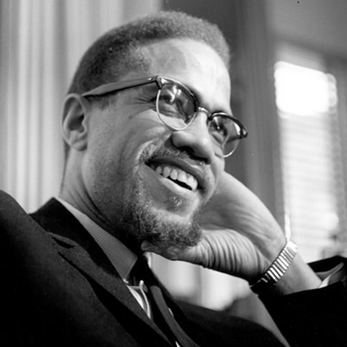
Discuss:
What is the author’s attitude
toward the collective white man?
2. What is the tone of the passage? Circle and discuss the words that reveal the tone of this passage.

Slide 17
Response
The author’s attitude toward the collective white man is one of vehemence and contempt.
The tone—expression of attitude—is denunciatory and indignant. The white man is called a piratical opportunist. He uses Faustian machinations, going so far as to sell his soul for power. He uses Christianity as a wedge in criminal conquests to subjugate non-white cultures and civilizations. These non-white victims are called ancient and, by implication, cultured and civilized, in contrast to the collective white man who deals only with power and weapons of war.

Slide 18
Tone #5
Consider:
The dry brown coughing beneath their feet,
(Only a while, for the handyman is on his way)
These people walk their golden gardens.
We say ourselves fortunate to be driving by today.
That we may look at them, in their gardens where
The summer ripeness rots. But not raggedly.
Even the leaves fall down in lovelier patterns here.
And the refuse, the refuse is a neat brilliancy.
--Gwendolyn Brooks, “Beverly Hills, Chicago”

Slide 19
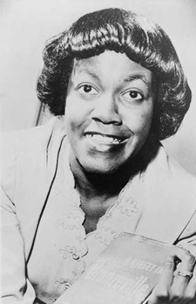
Discuss:
Who is the we (line 4) of the poem?
Who are these people (line 3)? What
is the poem’s attitude toward these
people?
Examine lines 6-8. Even rot and refuse
is neat and brilliant, and leaves fall
down in lovelier patterns here. What
image does the diction create? How does that image contribute to the tone?

Slide 20
Response
The we in line four is the persona and her companions. The poem is told in the persona’s voice, and the scene is observed through her eyes. The we in the poem are observers of the wealthy, not wealthy themselves. These people are the wealthy people of the golden gardens. They are people of privilege, to be observed not admired; for although the persona proclaims ourselves fortunate to be driving by today, the good fortune is mixed with irony. These people walk with a dry brown coughing beneath their feet and are unable to solve their own problems (the handyman is on his way).
They may have golden gardens, but even there the summer ripeness rots. The refuse may be a neat brilliancy, but there is refuse. These people are too perfect. They have no vitality and ring as hollow as the dry brown coughing beneath their feet.

Slide 21
Response
2. The image is of perfect order and sterility. The leaves are patterned, summer rot is not raggedy, and the refuse is neat. These images reinforce the ironic tone of the poem. The we of the poem are allowed to look at them, as if these people are superiors, set apart But their patterned leaves and neat refuse only serve to fix the image of their lives as sterile, impassive, and unreal.

Slide 22
Tone #6
Consider:
DiMaggio burst upon the nation just nine years after Charles Lindbergh almost inadvertently invented celebrity of a degree—or a kind, really—never before experienced. DiMaggio played a team game but somehow knew, in the intuitive way an artist has of knowing things, that our rough-and-tumble democracy, leveling though it is, responds to an individual with an aura of remoteness.
--George F. Will, “The First Michael Jordan”

Slide 23
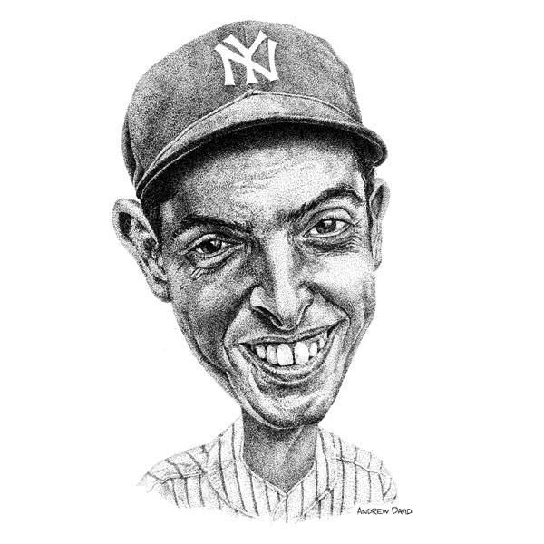
Discuss:
What is Will’s attitude toward
DiMaggio?
2. Identify elements of diction,
detail, imagery, and syntax that
create the tone.

Slide 24
Response
Will’s writing about DiMaggio is quite informal, but underlying his description is an attitude of respect and esteem.
There is much crossover among diction, detail and imagery. All of these contribute to the tone.
Diction: burst, celebrity, intuitive, rough-and-tumble democracy, aura, remoteness
Detail: DiMaggio burst upon the nation. Charles Lindbergh almost inadvertently invented celebrity of a degree—of a kind, really—never before experienced. DiMaggio played a team game.

Slide 25
Response
Imagery: An individual with an aura of remoteness
A team game
DiMaggio burst upon the nation
Syntax: DiMaggio burst upon the nation just nine years after Charles Lindbergh almost inadvertently invented celebrity of a degree—of a kind, really—never before experience
DiMaggio played a team game but somehow knew, in the intuitive way an artist has of knowing things, that our rough-and-tumble democracy, leveling though it is, responds to an individual with an aura of remoteness.

Slide 26
Tone #7
Consider:
JACK (slowly and hesitantly): Gwendolen—Cecily—it is very painful for me to be forced to speak the truth. It is the first time in my life that I have every been reduced to such a painful position, and I am really quite inexperienced in doing anything of the kind. However I will tell you quite frankly that I have no brother Ernest. I have no brother at all. I never had a brother in my life, and I certainly have not the smallest intention of ever having one in the future.
--Oscar Wilde, The Importance of Being Ernest

Slide 27
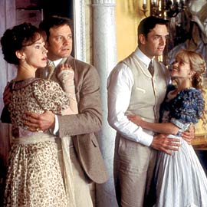
Discuss:
What is Wilde’s attitude toward Jack? What specific diction and detail reveal his attitude?
What is Wilde’s attitude toward the reader? How do you know.?

Slide 28
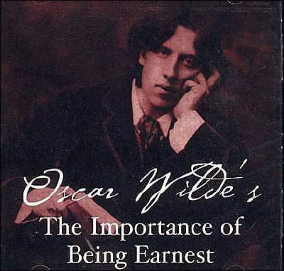
Response
Wilde characterizes Jack as a frivolous, silly man with weak morals. It is painful for him to speak the truth. It is the first time in his life that he has spoken the truth, and it is painful for him to do so. Further, his reference to having a brother, I have not the smallest intention of ever having one in the future, as if it were in his control,
underscores his shallow
pretentiousness.

Slide 29
Response
2. Wilde’s tone is satirical: he mocks Jack and his whole world of superficial, pretentious compatriots. His attitude toward the reader—conspiratorial and concurrent– sets the tone. Wilde assumes an audience in concord. Jack’s seriously delivered lines would fall flat without an audience that 1) recognizes the familiarity of people like Jack; 2) sees the comic potential of someone who admits to putting pretense and the appearance of virtue over real virtue; and 3) recognizes the ironic honesty of stating truthfully the preference for pretense over truth.

Slide 30
Tone #8
Consider:
In Pride, in reasoning Pride, our error lies;
All quit their sphere, and rush into the skies.
Pride still is aiming at the best abodes,
Men would be Angels, Angels would be Gods.
Aspiring to be Gods, if Angels fell,
Aspiring to be Angels, Men rebel:
And who but wishes to invert the laws
Of Order, sins against th’ Eternal Cause.
--Alexander Pope, “An Essay on Man”

Slide 31
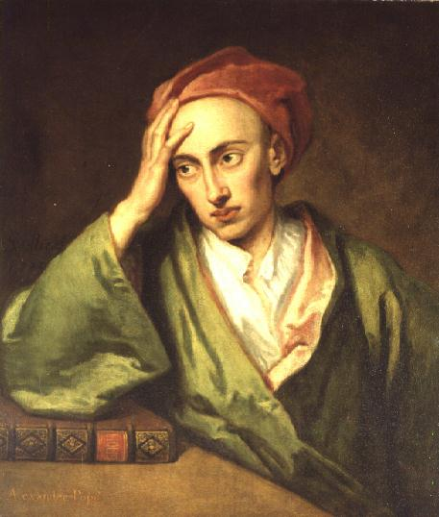
Discuss:
What is Pope’s attitude toward pride, the subject matter? Cite your evidence.
What is the tone of the passage?
What attitude underlies the tone?

Slide 32
Response
1. Pope’s attitude, typical of neoclassical writing, is that there is a natural order to things; and any one who tampers with the natural order is guilty of pride. Pride, according to Pope, is the cause of much suffering and evil in the world. He states this simply in the first line of the passage: In Pride, in reasoning Pride, our error lies. He compares the pride of men to the pride of angels with the intent of stressing the dangers of perverting the “natural order” of things: Aspiring to be Gods, if Angels fell,/Aspiring to be Angels, Men rebel. Pope furthers his argument by comparing Satan’s fall from grace (when he rebelled against God) to man’s fall to his ruin if he gives into pride: And who but wishes to invert the laws/Of Order, sins against th’ Eternal Cause.

Slide 33
Response
2. The tone of this passage is didactic. In other words, the intent of the passage is to instruct. The attitude that underlies the tone is the attitude toward the reader, his audience. Pope assumes a superiority and views the reader as one needing instruction and edification. That is why Pope’s writing often sounds preachy. He emphasizes words with capital letters and speaks with great authority and certainty: In Pride, in reasoning Pride, our error lies. And he assumes an absolute knowledge of God’s plan: who but wishes to invert the laws/Of Order, sins against th’ Eternal Cause. Tone can be shaped by the author’s (or narrator’s) attitude toward subject matter, the audience, or both. Here tone is determined by the author’s attitude toward the audience.

Slide 34
Tone #9
Consider:
Shug come over and she and Sofia hug.
Shug say, Girl, you look like a good time, you do.
That when I notice that Shug talk and act sometimes like a man. Men say stuff like that to women, Girl, you look like a good time. Women always talk bout hair and health. How many babies living or dead, or got teef. Not bout how some woman they hugging on look like a good time.
--Alice Walker, The Color Purple

Slide 35
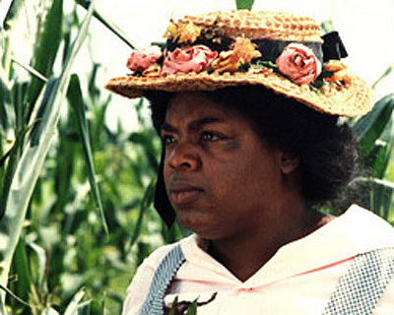
Discuss:
What is the tone of this passage: what attitude toward Shug, toward men, and toward women underlies the passage?
Walker repeats the phrase, look like a good time, three times in the passage. How does this use or repetition help create the tone of the passage?

Slide 36
Response
1. The narrator’s attitude toward Shug is one of wonder and veneration. She describes Shug with exuberance and power, comparing Shug’s actions to those of men, those with power. Shug talk and act sometimes like a man. Women always talk bout hair and health. How many babies living or dead, or got teef. Women reflect with their conversation. Their concerns are not active, but rest with accepting things that happen to them and those they love. Men, on the other hand, are active. Their words are lively and suggest activity and fun: Girl, you look like a good time. By allying Shug with men, the narrator gives her power and life and establishes her reverential tone.

Slide 37

Response
The use of repetition reinforces the narrator’s tone of wonder. The first mention of the phrase is a direct quote, Shug’s words: Girl, you look like a good time, you do. The second and third mentions are reflections on Shug’s character. The use of repetition recreates the narrator’s surprise at Shug’s power and strengthens the reader’s understanding of the narrator’s wonder.

Slide 38
Tone #10
Consider:
And I started to play. It was so beautiful. I was so caught up in how lovely I looked that at first I didn’t worry how I would sound. So it was a surprise to me when I hit the first wrong note and I realized something didn’t sound quite right. And then I hit another and another followed that. A chill started at the top of my head and began to trickle down. Yet I couldn’t stop playing, as though my hands were bewitched. I kept thinking my fingers would adjust themselves back, like a train switching to the right track. I played this strange jumble through two repeats, the sour notes staying with me all the way to the end.
--Amy Tan, The Joy Luck Club

Slide 39

Discuss:
How does the narrator’s attitude toward her performance change in the passage?
How does the author’s use of
detail, diction, and imagery
reveal the narrator’s changing
attitude?

Slide 40
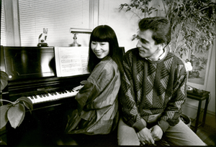
Response
1. In the beginning of the passage, the narrator is caught up with a romanticized image of how she looks and plays. She is enamored with the image of herself playing beautifully and looking lovely. However, the tone changes as she begins to hit wrong notes. With her inability to correct her playing, the tone changes from upbeat admiration to horror.

Slide 41
Response
2. Every element of the paragraph supports the changing tone. The diction in the beginning of the paragraph is positive but general. The recital is beautiful. The narrator looks lovely and doesn’t worry about her performance. As the description shifts to the debacle that follows, diction, detail, and imagery become more specific, reflecting the narrator’s building horror. She realizes something [doesn’t] sound quite right. She gets a chill that start[s] at the top of her head and trickle[s] down; her hands [are] bewitched; she plays a strange jumble with sour notes. She even helplessly searches for an outside control of her actions: I kept thinking my fingers would adjust themselves back, like a train switching to the right track. However, nothing comes to her aid, and she is left with her strange jumble and its accompanying horror until the end of her performance.

Slide 42
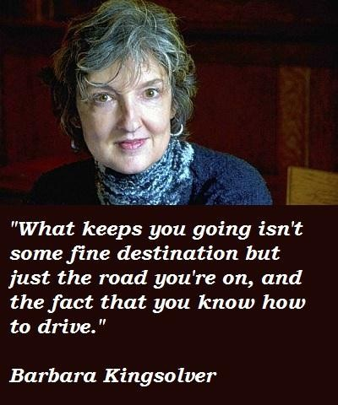
Diction #1
Consider:
Art is the antidote that can call us back from the edge of numbness, restoring the ability to feel for another.
--Barbara Kingsolver,
High Tide in Tucson

Slide 43

Discuss:
1. By using the word antidote, what does the author imply about the inability to feel for another?
2. If we changed the word antidote, to gift, what effect would it have on the meaning of the sentence?

Slide 44
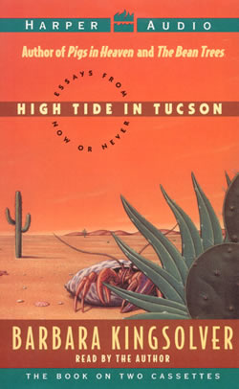
1. An antidote is something that counteracts a poison. By associating antidote with the restoration of ability to feel for another, Kingsolver implies that the inability to feel for another is a poison. Further, this poison is so noxious as to take us to the edge of numbness.
2. The use of the word gift instead of antidote weakens the precision of the sentence and takes away its power of association. Gift is a much more general word than antidote, and it does not offer the implicit judgment about the inability to feel for another.
Response

Slide 45
Diction #2
Consider:
Newts are the most common salamanders. Their skin is a lighted green, like water in a sunlit pond, and rows of very bright red dots line their backs. They have gills as larvae; as they grow they turn a luminescent red, lose their gills, and walk out of the water to spend a few years padding around in damp laces on the forest floor. Their feet look like fingered baby hands, and they walk in the same leg patterns as all four-footed creatures—dogs, mules, and, for that matter, lesser pandas.
--Annie Dillard, Pilgrim at Tinker Creek

Slide 46

Discuss:
What is the difference between a lighted green and a light green? Which one do you think creates a more vivid picture?
What is the effect of saying fingered baby hands instead of simply baby hands?

Slide 47
Response
The difference is one of quality an dimension. Lighted green implies a luminescence, a brilliance that almost seems reflected. The diction thus goes beyond color and expresses a relationship with its environment. Light green simply expresses a shade of green. Lighted green is more specific and exact; it creates a more vivid picture.
Since baby hands do have fingers, comparing newts’ feet to fingered baby hands serves to emphasize the fingers, drawing attention to the importance of this characteristic. It is also an unusual use of words. Words used in an unexpected and unusual way make us rethink the way we see things and re-examine meaning.

Slide 48
Diction #3
Consider:
Twenty bodies were thrown out of our wagon. Then the train resumes its journey, leaving behind it a few hundred naked dead, deprived of burial, in the deep snow of a field in Poland.
--Elie Wiesel, Night

Slide 49

Discuss:
The scene describes the transporting of Jews from Auschwitz to Buchenwald, both concentration camps in World War II. In the selection, Wiesel never refers to the men who die on the journey as men. Instead, he refers to them as bodies or simply dead. How does his diction shape the reader’s understanding of the horror?
How would the meaning change
if we substituted dead people for
bodies?

Slide 50
Response
By referring to the dead men as bodies or simply dead. Wiesel demonstrates the horror of the experience. Men have become dehumanized both in the eyes of the Nazis and in their own eyes. They have been stripped of all possessions, loved ones, and dignity. When they die, they simply become bodies, trash to be discarded. His diction reflects this horror.
The passage would lose its power if we substituted dead people for bodies. The use of dead people recognizes a vestige of humanity which does not suit Wiesel’s purpose. The exact diction of the original passage—complete with the horror or its connotation –focuses the reader’s attention and allows the reader to respond with conviction to the impact of the scene.

Slide 51
Diction #4
Consider:
This is earthquake
Weather!
Honor and Hunger
Walk lean
Together.
--Langston Hughes, “Today”

Slide 52
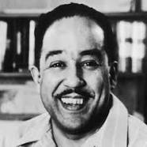
What does lean mean in this context?
Is lean a verb, an adjective, or both? How does this uncertainty and complexity contribute to the impact of the lines?

Slide 53
Response
Lean means both inclining for support, and containing little or no fat. Both meanings make sense in this context.
Lean works as both verb and an adjective. Hunger can be borne better if it can lean on honor; hunger can make honor lean, spare and reluctant; honor and hunger (both physical and emotional) can lean on each other and honor together can make for a lean lifestyle. This uncertainty gives richness and intricacy to the meaning. Poets often strive for multiple meanings of words to give their poetry complexity and depth.

Slide 54
Diction #5
Consider:
“Ahhh,” the crowd went, “Ahhh,” as at the most beautiful of fireworks, for the sky was alive now, one instant a pond and at the next a womb of new turns: “Ahhh,” went the crowd, “Ahhh!”
--Norman Mailer, “Of a Fire on the Moon”

Slide 55

Discuss:
This quote is a from a description of the Apollo-Saturn launching. The Saturn was a huge rocket that launched the Apollo space capsule, a three-man ship headed for the moon. Why is the sky described as a pond then a womb? Contrast the two words. What happens that changes the sky from a pond to a womb?
What does Mailer’s use of the word womb tell the reader about this attitude toward the launch?

Slide 56
Response
The sky is identified with a pond at first because it is simply a container (as the pond contains water, so does the sky contain air), for the Apollo-Saturn to enter. The sky also has the reflective quality of a pond and the same mystery of the unknown. The transformation into a womb happens when the launch is complete. The sky then becomes both receptacle and progenitor for a new era of exploration.
His use of the word womb tells the reader that Mailer sees great potential in the possibilities of space exploration. The launching of the Apollo-Saturn is viewed like the birth of a baby: full of hope, promise and joy.

Slide 57
Diction #6
Consider:
Pots rattled in the kitchen where Momma was frying corn cakes to go with vegetable soup for supper, and the homey sounds and scents cushioned me as I read of Jane Eyre in the cold English mansion of a colder English gentleman.
--Maya Angelou, I know Why the Caged Bird Sings

Slide 58

Discuss:
By using the word cushioned, what does Angelou imply about her life and Jane Eyre’s life?
What is the difference between cold of the English mansion and the cold of the English gentleman? What does Angelou’s diction convey about her attitude toward Jane’s life?

Slide 59
Response
Angelou implies, through diction, that her life is more comfortable than Jane Eyre’s is. The warm sounds and scents of her home comfort her as she reads about Jane’s difficult and cold life.
The difference lies in focus and degree. The cold of the English mansion is both a literal and figurative one. The mansion is cold in temperature ; it is also sterile and barren, lacking emotional warmth and ease. The cold of the English gentleman is strictly emotional. This is the worst sort of cold, for he is colder than the mansion itself. Angelou’s attitude toward Jane Eyre’s life is one of sympathy and concern. Also underlying this passage is gladness for her own life, one far removed from Jane Eyre’s.

Slide 60
Diction #7
Consider:
Abuelito, under a bald light bulb, under a ceiling dusty with flies, puffs his cigar and counts money soft and wrinkled as old Kleenex.
--Sandra Cisneros, “Tepeyac,” Woman Hollering Creek and Other Stories

Slide 61

Discuss:
How can a ceiling be dusty with flies? Are the flies plentiful or sparse? Active or still? Clustered or evenly distributed?
What does Cisneros mean by a bald light bulb? What does this reveal about Abuelito’s room?

Slide 62
Response
A ceiling that is dusty with flies has so many flies on it that they almost look like particles of dust. The flies are active, moving in a random fashion like dust particles in air. They are evenly distributed and thick on the ceiling, like dust.
A bald light bulb is one with no shade or cover of any kind. The image it evokes is one of sparseness and poverty. The bald light bulb in the sentence thus reveals Abuelito’s room to be poor and sparsely furnished.

Slide 63
Diction #8
Consider:
Most men wear their belts low here, there being so many outstanding bellies, some big enough to have names of their own and be formally introduced. Those men don’t suck them in or hide them in loose shirts; they let them hang free, they pat them, they strike them as they stand around and talk.
--Garrison Keillor, “Home,” Lake Wobegon Days

Slide 64

Discuss:
What is the usual meaning of outstanding? What is its meaning here? What does this pun reveal about the attitude of the author toward his subject?
Read the second sentence again. How would the level of formality change if we changed stuck to pull and let them hang free to accept them?

Slide 65
Response
Outstanding usually means prominent, superior, or distinguished. The meaning here is large: “standing out” in its literal sense; prominent—not in importance but in size. The pun reveals an accepting light-hearted attitude about the subject. It also implies pride, an affectionate acknowledgment of an “accomplishment.” Keillor makes a gentle joke rather than criticizing or mocking.
The level of formality would change from colloquial to simply informal. The use of suck and let them hang free is conversational, speech-like slang. This low level of formality reinforces the warmth and humor of the first sentence.

Slide 66
Diction #8
Consider:
…then Satan first knew pain,
And writh’d to and fro convolv’d; so sore
The grinding sword with discontinuous wound
Passed through him.
--John Milton, Paradise Lost, Book VI, lines 327-330

Slide 67
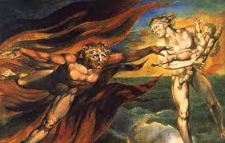
Discuss:
By using the word grinding what does Milton imply about the pain inflicted by the sword?
What does discontinuous mean? How does the use of discontinuous reinforce the idea of a grinding sword?

Slide 68
Response
Grinding means to crush or pulverize by friction. A grinding sword thus does not produce a clean cut. Instead, it uses a rubbing or crushing motion to inflict its injury. The implication is one of heightened pain brought about by rough motion, the turning and crushing of the sword.
Discontinuous means marked by breaks or interruptions. The word reinforces the idea of a grinding sword by echoing the motion of the sword. Grinding is an intermittent action, so the wound is discontinuous. The pain is also echoed in the diction. Relief from the intermittent pain carries with it the expectation of more pain: even periods of rest are painful.

Slide 69
Diction #9
Consider:
Meanwhile, the United States Army, thirsting for revenge, was prowling the country north and west of the Black Hills, killing Indians wherever they could be found.
--Dee Brown, Bury My Heart at Wounded Knee

Slide 70
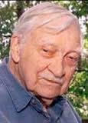
Discuss:
What are the connotations of thirsting?
What feelings are evoked by this diction?
2. What are the connotations of prowling What kind of animals prowl? What attitude toward the US army does this diction convey?

Slide 71
Response
Along with the inclination to drink, thirsting connotes insistent desire, craving, and yearning. The feelings evoked here are intense desire, craving beyond a physical need, and frantic action. This search for revenge goes beyond the rational and sinks to the level of animal impulse.
Prowling connotes stealth, craftiness, and predation. Animals prowl that steal up on their prey: coyotes, wolves, lions, and other animals that stalk to hunt. The diction here places the US army squarely in the company of these predatory animals. The connotation is, of course, purposeful; Brown’s attitude toward the army is that they are predatory animals.

Slide 72
Diction #10
Consider:
Once I am sure there’s nothing going on
I step inside, letting the door thud shut.
--Philip Larkin, “Church Going”

Slide 73
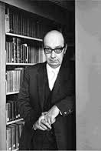
Discuss:
What feelings are evoked by the word thud?
How would the meaning change if the speaker let the door slam shut?

Slide 74
Response
A thud is a dull sound, like a heavy object striking a solid surface. It evokes feelings of seriousness and finality. Since it is not a sharp sound, thud also connotes a feeling of secrecy, a quiet but unequivocal closing.
The slamming of a door is sharper and louder than a thud. It connotes impatience or anger. It carries none of the secrecy and finality of the thud. Instead, a slam announces itself and seeks attention.

Slide 75
Detail #1
Consider:
She was wearing her usually at-home vesture….It consisted mostly of a hoary midnight-blue Japanese kimono. She almost invariably wore it through the apartment during the day. With its many occultish-looking-looking folds, it also served as the repository for the paraphernalia of a very heavy cigarette smoker and an amateur handyman; two oversized pockets had been added at the hips, and they usually contained two or three packs of cigarettes, several match folders, a screwdriver, a claw-end hammer, a boy scout knife that had once belonged to one of their sons and an enamel faucet handle or two, plus an assortment of screws, nails, hinges, and ball-bearing casters, all of which tended to make Ms. Glass chink faintly as she moved in her large apartment.
--J.D. Salinger, Franny and Zooey

Slide 76
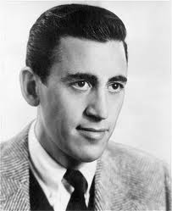
Discuss:
What does the details in this passage reveal about Mrs. Glass’s character? In other words how do the details give you a picture of her looks and insight into her character?
How would the meaning of the fourth sentence (With its many….) be different without the detail that follows the semicolon?

Slide 77
Response
Mrs. Glass’s clothing reveals several aspects of her personality. That she is wearing a Japanese kimono (not the usual American at home wear) with occultish-looking folds sets her apart as odd or, at least, unusual. Her clothes reveal her heavy smoking habit and her avocation as family handyman. She is not then, a traditional housewife. There is no seeming order or purpose for her tools, an indication of an absent-minded eccentricity. The fact that she chinks as she walks around the apartment reveals her essential presence there: she is not easily ignored or dismissed.

Slide 78
Response (continued)
2. The details make the general, first part of the sentence, specific and concrete. The central quality and significance of her clothing are sharpened and focused by the details. Sharpening of details indicate the large scale importance and high value of her clothing and by implication, the character herself. This emphasis would be lost if the sentence ended with a semicolon.

Slide 79
Detail #2
Consider:
The dog stood up and growled like a lion, stiff-standing hackles, teeth uncovered as he lashed up his fury for the charge. Tea Cake split the water like an otter, opening his knife as he dived. The dog raced down the back-bone of the cow to the attack and Janie screamed and slipped far back on the tail of the cow, just out of reach of the dog’s angry jaws.
--Zora Neale Hurston, Their Eyes Were Watching God

Slide 80
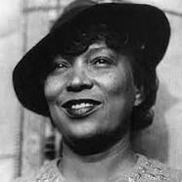
Discuss:
Which details reveal that the dog has rabies? What effect do these details have on the reader?
Contrast the details used to describe Tea Cake (the male protagonist) and Jane (the female protagonist). What do these details reveal about the author’s attitude toward these two characters?

Slide 81
Response
The details that reveal the dog has rabies are the dog’s growling like a lion, the stiff-standing hackles, the uncovered teeth, the fury, the frantic run to attack Janie, and the angry jaws. These details re-create the terror of the scene and make the reader a full participant in the action.
The details used to describe Tea cake show him to be active and in control: He splits the water, opens his knife, and dives. Janie, on the other hand, is described with details that are passive and helpless: She screams and slips out of reach. These details reveal a traditional attitude toward men, women, and these two characters: men (specifically, Tea Cake) are proactive, purposeful and protective: women (specifically, Jane) are reactive, passive and protected.

Slide 82
Detail #3
Consider:
We went upstairs, through period bedrooms swathed in rose and lavender silk and vivid with new flowers, through dressing-rooms and poolrooms, and bathrooms, with sunken baths –intruding into one chamber where a disheveled man in pajamas was doing liver exercises on the floor.
--F. Scott Fitzgerald, The Great Gatsby

Slide 83

Discuss:
List three general adjectives that you could use to describe this house. Explain the connection between the detail in Fitzgerald’s sentence and the adjectives you have chosen.
How does the disheveled man in pajamas…doing liver exercises on the floor help create the mood and atmosphere of the house?

Slide 84
Response
Students’ lists may include such adjectives as lavish, ornate, rich, expensive, costly, elegant, grandiose, pompous, flashy, ostentations, flamboyant, gaudy, decadent, showy and splendid. The connections to Fitzgerald’s details will vary with the adjectives the students choose.
Details about the man contribute to the decadent mood of the house. It is as if the man is simply another part of the décor, a guest with little productive to do. The fact that he is disheveled hints at overindulgence, a lack of discipline and order.

Slide 85
Detail #4
Consider:
An old man, Don Tomasito, the baker, played the tuba. When he blew into the huge mouthpiece, his face would turn purple and his thousand wrinkles would disappear as his skin filled out.
--Alberto Alvaro Rios, “The Iguana Killer”

Slide 86

Discuss:
The first sentence is a general statement. How does the second sentence enrich and intensify the first?
Contrast the second sentence with the following:
When he blew the tuba, his face turned purple and his cheeks puffed out.
Which sentence more effectively expresses an attitude toward Tomasito? What is that attitude and how is it communicated?

Slide 87
Response
It brings the scene into sharp focus. By describing the specific details of his face, the author communicates the intensity of the effort; and the reader can almost hear the sound of the tuba.
Rios’s sentence more effectively communicates an attitude toward Tomasito. The attitude is one of admiration. Tomasito is an old man. Nevertheless, he blows into a huge mouthpiece, suggesting power. Further, his wrinkles disappear as he blows into the trumpet, indicating a timelessness, a return to youthful vigor as he plays.

Slide 88
Detail #5
Consider:
The wild gander leads his flock through the cool night,
Ya-honk he says, and sounds it down to me like an invitation,
The pert may suppose it meaningless, but I listening close,
Find its purpose and place up there toward the wintery sky.
The sharp-hoof’d moose of the north, the cat on the house-sill, the chickadee, the prairie-dog,
The litter of the grunting sow as they tug at her teats,
The brood of the turkey-hen and she with her half-spread wings,
I see in them and myself the same old law.
--Walt Whitman, “Song of Myself,” Leaves of Grass

Slide 89
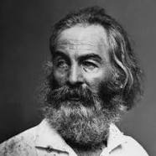
Discuss:
What is the conclusion of the last line? Which details in the passage support this conclusion?
The animals in these stanzas are specific and detailed. In contrast, the ambience (the cool night, the wintery sky) is more general. What attitude is revealed by this difference?

Slide 90
Response
1. The conclusion of the last line is that the “I” or persona of the poem is at one with all creatures and subject to the same laws: life, procreations, and ultimately death. Details that support this conclusion are the perceived invitation of the wild gander; the variety of animal life in line 5 (the lack of detail in this line indicates an equality of the animals form, the belief that no animal is more important than another); the sow with her young; and the turkey-hen with her brood. The persona of the poem gives equal weight to his own experience and the experience of other animals.

Slide 91
Response (continued)
2. The difference in the use of detail reveals a difference in attitude. Animals and humans are enmeshed in rhythms of birth, life, and death. The sky and the night are impersonal and impassive: they do not embody the life and death rhythms of animals. Since the sky and the night are not the focus of these lines, they are best described in general terms. Extensive detail is reserved for what is given higher value in the poem.

Slide 92
Detail #6
Consider:
CHARLEY (to WILLY): Why must everybody like you? Who liked J.P. Morgan? Was he impressive? In a Turkish bath he’d look like a butcher. But with his pockets on he was very well liked. Now listen, Willy, I know you don’t like me, and nobody can say I’m in love with you, but I’ll give you a job because—just for the hell of it, put it that way. Now what do you say?
--Arthur Miller, Death of a Salesman

Slide 93
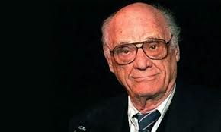
Discuss:
Who was J.P. Morgan? What is a Turkish bath? What picture comes to mind when someone is said to look like a butcher? How do these details contribute to the point Charley is trying to make?
How would the passage be different if Charley said J.P. Morgan would look like a baker in a Turkish bath?

Slide 94
Response
1. John Pierpont Morgan (1837-1913) was an U.S. businessman, financier, and steel industrialist. He co-founded the US Steel Corporation in 1901 and served as chairman from 1927 until 1932. He is mentioned here because of his wealth and influence. A Turkish bath is a public bath in which the bather passes through a series of steam rooms of increasing temperature and then receives a rubdown, massage, and cold shower. A butcher is usually pictured as someone large, strong, and somewhat overweight. The stereotype contrasts with the refined image of someone of great wealth and sophistication, like J.P. Morgan. J.P. Morgan was rich and influential, yet he won no beauty or popularity contest. The details about J.P. Morgan illustrate and exemplify the point that it isn’t necessary for everyone to like Willy or for Willy to be “impressive.”

Slide 95
Response (continued)
2. A baker is usually pictured as somewhat overweight; but being a baker does not carry the connotation of brute force, of bone-cracking strength. Further, a baker does not work with raw meat and blood, aspects of a butcher’s job that make him seem more coarse, less refined. A baker is more “earthy.” He creates while a butcher dismembers. If J.P. Morgan “looked like a baker,” the passage would be softened and Charley would have a weaker argument.

Slide 96
Detail #7
Consider:
To those who saw him often he seemed almost like two men: one the merry monarch of the hunt and banquet and procession, the friend of children, the patron of every kind of sport; the other the cold, acute observer of the audience chamber or the Council, watching vigilantly, weighing arguments, refusing except under the stress of great events to speak his own mind.
--Winston Churchill, “King Henry VIII,” Churchill’s History of the English-Speaking Peoples

Slide 97
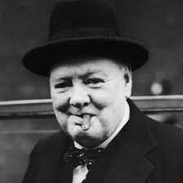
Discuss:
Churchill draws attention to the contrasting sides of Henry VIII through detail. How is the impact of this sentence strengthened by the order of the details’ presentation?
What is Churchill’s attitude toward Henry? What specific details reveal this attitude?

Slide 98
Response
1. The lighthearted side of Henry presented with detail reveals a decreasing absorption with responsibilities. First, he is a monarch, if a merry one. Next, he is a friend of children, details which give him a softness but keep a connection to his responsibilities. Finally, he is a patron of sports, which shows him to be a fun-loving man, totally detached at times from his responsibilities. Henry’s other side is presented in an order of decreasing importance. He is first an observer, which is both passive and detached. He then watches vigilantly and weighs arguments, acts which are more active and controlling. Finally, he refuses to speak, which is almost violent in its effects. The verbs and their accompanying detail are increasingly active and aggressive. The order of details thus intensifies the description of Henry and gives it focus.

Slide 99
Response (continued)
2. Churchill’s attitude is detached and fair. He presents the two sides of Henry’s personality in clauses which contain detail of equal weight. The merry monarch is balanced with the cold, acute observer; the friend of children is balanced with the watcher and weigher; the patron of sport is balanced with the refuser. This balance of detail allows the reader to reserve judgment and stay open to further character development.

Slide 100
Detail #8
Consider:
The truck lurched down the goat path, over the bridge and swung south toward El Puerto. I watched carefully all that we left behind. We passed Rosie’s house and at the clothesline right at the edge of the cliff there was a young girl hanging out brightly colored garments. She was soon lost in the furrow of dust the truck raised.
--Rudolfo Anaya, Bless Me, Ultima

Slide 101
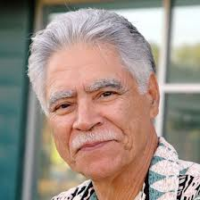
Discuss:
Circle the words that provide specific detail and contribute to the power of the passage.
Contrast the third sentence with:
  We passed Rosie’s house and saw a girl hanging out the clothes.
  Explain the difference in impact.

Slide 102
Response
Students should circle such words as goat path, the edge of the cliff, brightly colored garments and the furrow of dust.
Anaya’s sentence is specific and concrete; it allows the reader to participate in this particular experience. The clothesline is at the edge of the cliff; the girl is young; the clothes are brightly colored garments; and the bright colors are in sharp contrast to the dust of the next sentence. This detail brings the setting into focus and prepares the reader to join the action.

Slide 103
Detail #9
Consider:
How fine it is to enter some old town, walled and turreted, just at approach of nightfall, or to come to some straggling village, with the lights streaming through the surrounding gloom; and then, after inquiring for the best entertainment that the place affords, to “take one’s ease at one’s inn.”
William Hazlitt, “On Going a Journey”

Slide 104
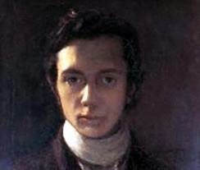
Discuss:
What details support the generalization, how fine it is?
What feelings are evoked by the details of the town (old, walled, turreted)? How does this selection of detail communicate Hazlitt’s attitude toward the town?

Slide 105
Response
Details that support the generalization how fine it is include entering a walled and turreted town, lights streaming through the surrounding gloom, and the best entertainment that the place affords. These details work together to create a feeling of warmth and comfort after a hard day’s travel.
The details create a romantic picture of a quaint town from another era. That the town is walled and turreted could create a feeling of foreboding and fear; but these details are preceded by an assertion of a fine experience, so they create instead a feeling of welcoming protection. Hazlitt’s attitude is thus established: this town will welcome home with warmth, protection and rest.

Slide 106
Detail #10
Consider:
In fact right behind her Gabriel could be seen piloting Freddy Malins across the landing. The latter, a young man of about forty, was of Gabriel’s size and build, with very round shoulders. His face was fleshy and pallid, touched with colour only at the thick hanging lobes of his ears and at the wide wings of his nose. He had coarse features, a blunt nose, a convex and receding brow, tumid and protruded lips. His heavy-lidded eyes and the disorder of this scanty hair made him look sleepy.
--James Joyce, “The Dead”

Slide 107
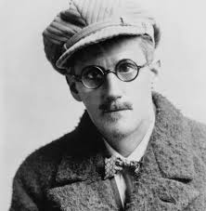
Discuss:
Joyce uses many specific details to describe Freddy’s physical appearance. List 6 details and state whether each detail is objective (making an observation) or evaluative (making a judgment).
2. What is Joyce’s attitude toward Freddy? Which specific details reveal his attitude?

Slide 108
Response
In general, objective details carry no strong connotation and reveal little about character. Evaluative details carry strong connotations and reveal insights about character. The evaluative details in this passage indicate a weakness in Freddy’s character by describing his physical appearance as fleshy and coarse. His face literally sags and indicates (since he is not old) a lack of resolve. Students may disagree as to which details are evaluative, which is excellent and may generate lively discussion.

Slide 109
Response
2. Joyce’s attitude toward Freddy is critical. Freddy’s fleshy, pallid face indicates weakness and unhealthiness. The touch of color on his nose indicates an over-indulgence in drink, and the coarse features indicate lack of mental and social refinement. The sleepy look of his heavy-lidded eyes and his disordered, scanty hair reveal a character ill-equipped to carry on normal intellectual and social interactions.

Slide 110
Imagery #1
Consider:
She looked into the distance, and the old terror flamed up for an instant, then sank again. Edna heard her father’s voice and her sister Margaret’s. She heard the barking of an old dog that was chained to the sycamore tree. The spurs of the cavalry officer clanged as he walked across the porch. There was the hum of bees, and the musky odor of pinks filled the air.
--Kate Chopin, The Awakening

Slide 111
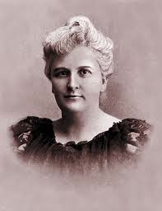
Discuss:
Although the narrator “looks into the distance,” the images are primarily auditory. What are the auditory images in the passage? What mood do these images create?
The last sentence of this passage contains an olfactory image (the musky odor of pinks fill the air). What effect does the use of an olfactory image, after a series of auditory images, have on the reader?

Slide 112
Response
Auditory images include her father’s voice, her sister Margaret’s voice, the barking of a dog, the spurs of a cavalry officer, and the hum of bees. These images create a mood of loneliness. All of the image of ordinary life are in the distance, audible but not immediate. Nothing directly interacts with Edna. She is a watcher and a listener, removed from the homely action of the passage.
The olfactory image brings the reader back to Edna. The auditory images are all in the distance. However, the olfactory image fill[s] the air. It shifts the reader’s attention and concern back to Edna and her loneliness.

Slide 113
Imagery #2
Consider:
The rainy night had ushered in a rainy morning—half frost, half drizzle—and temporary brooks crossed our path, gurgling from the uplands.
--Emily Bronte, Wuthering Heights

Slide 114
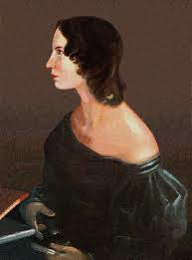
Discuss:
Bronte uses both visual and auditory imagery in this passage. Which words create visual images? Which words create auditory images? Which words create both?
What feelings are traditionally associated with rain, mist, and frost? How would the feelings of this passage be different if the rainy night had ushered in a brilliant, sunny morning?

Slide 115
Response
Images include the following: Visual imagery: misty morning—
half frost, half drizzle (temporary brooks crossed our path);
Auditory imagery: gurgling from the uplands; Both—rainy night,
temporary brooks crossed our path.
The feelings traditionally associated with rain, mist, and frost
are depression, dejection, and melancholy. That mist and frost
follow a rainy night offers neither relief from the weather nor the
corresponding hope for better times in general. A brilliant sunny
morning sets a tone for hopefulness and optimism in general.

Slide 116
Imagery #3
Consider:
The egwugwu was now a pandemonium of quavering voices: Aru oyim de de de dei! filled the air as the spirit of the ancestors, just emerged from the earth, greeted themselves in their esoteric language.
--Chinua Achebe, Things Fall Apart

Slide 117

Discuss:
Read the passage aloud. How does Achebe’s use of the Ibo
language contribute to the reader’s ability to “hear” the auditory imagery?
Compare Achebe’s passage with The “egwugwu” was now full of voices which filled the air as the spirits of the ancestors, just emerged from the earth, greeted themselves in their esoteric language.
In which passage can the reader “hear” the voices? How does the ability to hear the voices help the reader understand the passage?

Slide 118
Response
Achebe’s use of the Ibo language recreates the scene in the reader’s mind, bringing immediacy and interest to the work. Rather than referring to the language, Achebe uses actual Ibo words. This causes the reader to pause and “listen” to the auditory imagery as he or she reads.
The reader can “hear” the words in Achebe’s passage. The pandemonium of quavering voices sets the rhythm and timbre of the voices, and the use of Ibo words allows the reader to fully participate in the scene.

Slide 119
Imagery #4
Consider:
A woman drew her long black hair out tight
And fiddled whisper music on those strings
And bats with baby faces in the violet light
Whistled, and beat their wings
And crawled head downward down a blackened wail
And upside down in air were towers
Tolling reminiscent bells, that kept the hours
And voices singing out of empty cisterns and exhausted wells.
--T. S. Eliot, “The Waste Land”

Slide 120
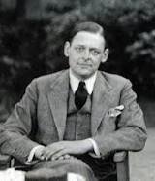
Discuss:
Paraphrase the image of the first two lines. What mood does the image create?
2. List the auditory images in these lines. How do these images help create the mood of the passage?

Slide 121
Response
Students’ paraphrases will vary. A paraphrase might read something like this: “A woman pulled her long black hair out to the side and held it taut. The she plucked her hair in such a way as to make a whispering sound.” The image creates a mood of eerie strangeness.

Slide 122
Response
2. The auditory images include a woman…fiddled whisper music on those strings, bats…whistled and beat their wings, towers tolling reminiscent bells, and voices singing out of empty cisterns and exhausted wells. The images help create the mood of the passage by reinforcing and intensifying the mood of eerie strangeness and desolation. None of the sounds are harmonious or uplifting. The woman fiddles on her hair, and the sound she produces is barely audible. Bats whistle and beat their wings, sounds without melody or harmony. The tolling of the bells evokes the past only and offers no hope for the future. Voices come from empty cisterns and dry wells. These images offer not hope: only decay, dissipation, and futility.

Slide 123
Imagery #5
Consider:
All the hedges are singing with yellow birds!
A boy runs by with lemons in his hands.
--Rita Dove, “Notes from a Tunisian Journal”

Slide 124
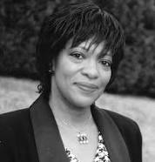
Discuss:
How does the image of the boy in the second line intensify your understanding of the hedges in the first line?
How would the effect be different if the second line read, “A boy runs by with apples in his hands”?

Slide 125
Response
The image of the boy with the lemons (line 2) picks up the color of the yellow birds from line 1. The color of the yellow birds becomes more specific and definite: it is the color of lemons.
A boy with apples produces an image that jars with the image of line one. In the first place, it introduces a new color and distracts the reader from the yellow of the first line. In addition, the apple does not have the connotation of zest and zing. The lines are exuberant, in keeping with the zing of lemons. Apples detract from the first image instead of intensifying it.

Slide 126
Imagery #6
Consider:
At first I saw only water so clear it magnified the fibers in the walls of the gourd. On the surface, I saw only my own round reflection. The old man encircled the neck of the gourd with his thumb and index finger and gave it a shake As the water shook, then settled, the colors and lights shimmered into a picture, not reflecting anything I could see around me. There at bottom of the gourd were my mother and father scanning the sky, which was where I was.
--Maxine Hong Kingston, The Warrior Woman

Slide 127
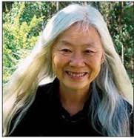
Discuss:
What kind of imagery is used in this passage? Identify the images.
Compare and contrast the imagery of the last sentence with the imagery of the first four sentences.

Slide 128
Response
The imagery used in this passage is visual. Images include clear water which magnifies the fibers of the gourd, the narrator’s reflection, the old man shaking the gourd, the colors and light shimmering in the water as it settles and the picture—in the bottom of the gourd—of the narrator’s mother and father scanning the sky.

Slide 129
Response
2. The imagery of the last sentence is full of precise and exact details, just like the imagery of the first four sentences. In addition, the whole passage is dominated by visual imagery. The difference lies in the visual imagery’s subject matter. The first four sentences offer concrete and realistic images, an exact representation of a scene. The last sentence, however, delves into a different reality. The imagery of the last sentence reveals the magic that is central to this passage: the narrator sees her parents, who are not there, reflected by the gourd, the use of consistent precision and exactness of imagery makes the magic of the last sentence believable and enables the reader to participate in the vision.

Slide 130
Imagery #7
Consider:
There were some dirty plates
and a glass of milk
beside her on a small table
near the rank, disheveled bed—
Wrinkled and nearly blind
she lay and snored
rousing with anger in her tones
to cry for food.
--William Carlos Williams, “The Last Words of My English Grandmother”

Slide 131
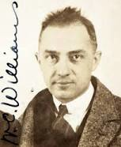
Discuss:
These stanzas contain visual, olfactory, auditory, and gustatory images. Create your own chart like the one below and fill with concrete images from the poem.
Visual Olfactory Auditory Gustatory
Contrast the attitude toward the old woman
in the two stanzas. How does it change?
What images create this change in attitude?

Slide 132
Response
Image charts can help you identify images and understand their significance. Students’ charts should include the following images:
Visual Olfactory Auditory Gustatory
Dirty plates Rank, disheveled bed Snored A glass of milk
A glass of milk Anger in her tones
Small table Cry for food
disheveled bed
Wrinkled and nearly blind

Slide 133
Response
2. The attitude toward the old woman in the first stanza is only slightly judgmental. She is a neutral participant in a filthy environment (some dirty plates, the rank, disheveled bed). In the second stanza, however, the attitude toward the old woman becomes harsh and critical. She is the center of the room’s disorder. She is wrinkled (like the bed) and nearly blind. However she is no pathetic victim. The auditory imagery (rousing with anger in her tones/to cry for food) reveals her to be demanding and self-centered, the embodiment of the room’s decay Indeed, she becomes a participant in the decay rather than a victim of it.

Slide 134
Imagery #8
Consider:
This is the time of year
When almost every night
the frail, illegal fire balloons appear.
Climbing the mountain height.
rising toward a saint
still honored in these parts,
the paper chambers flush and fill with light
that comes and goes, like hearts.
--Elizabeth Bishop, “The Armadillo (for Robert Lowell)”

Slide 135
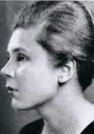
Discuss:
Read the two stanzas aloud. What kind of imagery does Bishop use in these lines? How does the use of imagery contribute to the reader’s understanding of the lines?
The image of the balloons rising and filling with light ends with a simile (like hearts). How is the effect of the simile different from that of the image?

Slide 136
Response
1. Bishop uses primarily visual imagery in these lines. Imagery reveals both the function and form of the fire balloons. The fire balloons occur at a certain time of the year (this time of year), probably associated with some holiday or ceremony. They are frail and illegal. When they are released, they rise toward the top of a mountain. In lines seven and eight, the reader becomes fully involved in the scene because of specific imagery: the paper chambers flush and fill with light/that comes and goes. The visual imagery re-creates the sight and allows the reader to experience it.

Slide 137
Response
2. The simile startles the reader and introduces an affective dimension to the scene. It reinforces the idea of the light’s coming and going with the auditory image of the heartbeat. In addition, it intimates that hearts (in the sense of love and loyalty) come and go, echoing the visual image of the paper chambers.

Slide 138
Imagery #9
Consider:
I also enjoy canoeing, and I suppose you will smile when say that I especially like it on moonlight nights. I cannot, it is true, see the moon climb up the sky behind the pines and steal softly across the heavens, making a shining path for us to follow, but I know she is there, and as I lie back among the pillows and put my hand in the water, I fancy that I feel the shimmer of her garments as she passes. Sometimes a daring little fish slips between my fingers, and often a pond-lily presses shyly against my hand. Frequently, as we emerge from the shelter of a cove or inlet, I am suddenly conscious of the spaciousness of the air about me. A luminous warmth seems to enfold me.
--Helen Keller, The Story of My Life

Slide 139
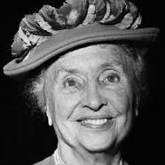
Discuss:
Since Helen Keller was blind and deaf, tactile imagery becomes a focus in her writing. Identify the tactile images in this passage.
Which images in the passage are more specific: visual or tactile? Support your answers with reference to the passage.

Slide 140
Response
Tactile images are I…put my hand in the water; a darling little fish slips between my fingers; a pond-lily presses shyly against my hand; I am suddenly conscious of the spaciousness of the air around me; and a luminous warmth seems to enfold me.
The tactile images are more specific than the visual ones. The moon climbing up the sky behind the pines creates only a generic picture for the reader. The moon has no phase; the pine has no particulars. Even the moon’s path is general and abstract: shining and shimmering with no color shape. The tactile images, on the other hand, are specific, concrete, and exact: the fish slips between [her] fingers; the plant she touches is a pond lily; the warmth that enfolds her is luminous. The tactile imagery allows the reader to fully participate in the scene and empathize with one who is limited to certain senses.

Slide 141
Imagery #10
Consider:
Queen: There is a willow grows askant the brook,
That shows his hoar leaves in the glassy stream.
There with fantastic garlands did she make
Of crowflowers, nettles, daisies, and long purples…
There on the pendent boughs her crownet weeds
Clamb’ring to hang, an envious sliver broke,
When down her weedy trophies and herself
Fell in the weeping brook. Her clothes spread wide,
And mermaid-like awhile they bore her up,
Which time she changed snatches of old lauds,
As one incapable of her own distress,
Or like a creature native and indued
Unto that element. But long it could not be
Till that her garments, heavy with their drink,
Pulled the poor wretch from her melodious lay
To muddy death.
--William Shakespeare, Hamlet

Slide 142
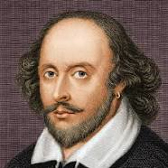
Discuss:
Examine lines 8-13. How does the imagery in these lines help the reader understand that Ophelia (the she of the lines) is mad?
Line 10 is not figurative. Would it strengthen or weaken the line to change the image to a simile such as, “Which time she sang like a flawed recording”? Defend your opinion.

Slide 143
Response
The imagery shows Ophelia’s madness by revealing that she does nothing to save herself from drowning. She is kept afloat only by her clothes (Her clothes spread wide,/And mermaid-like awhile they bore her up). She sings songs as she floats, buoyed up by her clothes, certain to drown (Which time she changed snatches of old lauds). And she is totally oblivious to her own danger (As one incapable of the own distress/Or like a creature native and indued/Unto that element).
The plaintive simplicity of the line—the image of Ophelia singing as she drowns—makes no judgment. Therein lies its strength. The image captures and reflects her simplicity and her oblivion to her own impending doom. A figure of speech would be, as the Bard himself says, gilding your fine gold.

Slide 144
Syntax #1
Consider:
The impact of poetry is so hard and direct that for the moment there is no other sensation except that of the poem itself. What profound depths we visit then—how sudden and complete is our immersion! There is nothing here to catch hold of; nothing to stay us on our flight….The poet is always our contemporary. Our being for the moment is centered and constricted, as in any violent shock of personal emotion.
--Virginia Woolf, “How Should One Read a Book?”

Slide 145
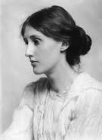
Discuss:
Woolf uses a variety of sentence types in this selection. Among them is the exclamatory sentence. Identify the exclamatory sentence and explain its effect.
Classify each sentence as to length: short, medium, or long. How is the meaning of the passage reinforced and clarified by sentence length?

Slide 146
Response
The exclamatory sentence is What profound depths we visit then—how sudden and complete is our immersion! The exclamatory sentence here serves to emphasize the immediacy and complete involvement found in reading poetry. Exclamatory sentences in general show deep feeling, excitement, and passion. When used sparingly, they provide contrast for the more decorous declarative sentences, and they express the strong feelings of the writer.

Slide 147
Response
2. There are five sentences in the passage. The first and second sentences are medium in length; the third and fifth sentences are long; and the fourth sentences (The poet is always our contemporary) is short. Placing a short sentence amidst several longer sentences serves to emphasize the short sentence and gives it weight. The central idea of the passage is carried by the short sentence and is intensified by its contrast with the longer sentences.

Slide 148

Syntax #2
Consider:
No sooner had the reverberation of my blows sunk into silence, then I was answered by a voice from within the tomb!—by a cry, at first muffled and broken, like the sobbing of a child, and then quickly swelling into one long, loud, and continuous scream, utterly anomalous and inhuman—a howl!—a wailing shriek, half of horror and half of triumph, such as might have arisen only out of hell, conjointly from the throats of the damned in their agony and of the demons that exult in the damnation.
--Edgar Allan Poe, “The Black Cat”

Slide 149

Discuss:
The dashes in this long sentence set off a series of appositives. (An appositive is a noun or noun phrase placed beside another noun or noun phrase and used to identify or explain it.) What noun phrase is explained by the appositives?
This sentence makes syntactic and semantic sense if it ends with the first exclamation point. What do the appositives add to the meaning and effectiveness of the sentence?

Slide 150
Response
The noun phrase explained by the appositives is a voice from within the tomb.
The main clause of this sentence is I was answered by a voice from within the tomb. It carries both the syntactic and semantic weight of the sentence. Syntactic closure (the completion of a grammatical structure) is thus achieved very early in the sentence. Syntactic closure relieves tension and allows the reader to explore the complex description of the voice in the tomb. Through the appositives, Poe increases the intensity of the cries. He moves from a voice (the main noun), to a cry, then to a howl, then to a shriek. The increasing intensity creates the mood of terror and reflects the narrator’s increasing madness.

Slide 151
Syntax #3
Consider:
He had been prepared to lie, to bluster, to remain sullenly unresponsive; but, reassured by the good-humored intelligence of the Controller’s face, he decided to tell the truth, straightforwardly.
--Aldous Huxley, Brave New World

Slide 152
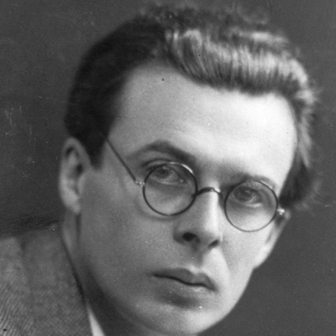
Discuss:
What effect does the repetition of infinitives (to lie, to bluster, to remain) in the first clause have on the meaning of the sentence? How do these infinitives prepare you for the infinitive phrase (to tell the truth) in the second clause?
What is the function of the semicolon in Huxley’s sentence?

Slide 153
Response
By repeated use of infinitives, Huxley balances the parallel sides, responses the speaker had prepared for the Controller, and gives them weight. The repeated infinitives also create the foundation for the contrast, completed in the second clause with another infinitive: to tell the truth.
The semicolon joins two independent clauses containing internal punctuation. The semicolon gives equal weight to both independent clauses, directing the reader to pay equal attention to the ideas in both.

Slide 154
Syntax #4
Consider:
The seven years’ difference in our ages lay between us like a chasm: I wondered if these years would ever operate between us as a bridge.
--James Baldwin, “Sonny’s Blues”

Slide 155
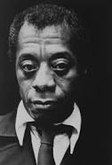
Discuss:
What function does the colon serve in this sentence?
How would the meaning and impact of the sentence change if the sentence read as follows:
  The seven years’ difference in our ages lay between us like a chasm, and I wondered if these years would ever operate between us as a bridge.

Slide 156
Response
Colons direct the reader’s attention to the words that follow and emphasize those words. The purpose of this colon is to indicate the closely related information will follow. The chasm of the first clause is connected to the bridge of the second clause, and the possibility of reconciliation for the characters in the sentence is raised through syntax.

Slide 157
Response
2. The change would shift the meaning and lessen the impact. Two independent clauses joined by a comma and conjunction indicate equal weight of both clauses; this syntax does not assume a prescribed relationship between the two clauses. Two independent clauses joined with a colon have a prescribed relationship: the second clause explains, summarizes, or amplifies the first. Baldwin’s sentence draws the connection between the chasm and the bridge with the colon and emphasizes the possibility of bridging the relationship. His syntax indicates semantic possibilities. The new version reduces the second clause to speculation and diminishes the connection between syntax and meaning.

Slide 158
Syntax #5
Consider:
He slowly ventured into the pond. The bottom was deep, soft clay, he sank in, and the water clasped dead cold round his legs.
--D. H. Lawrence, “The Horse-Dealer’s Daughter”

Slide 159
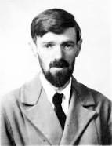
Discuss:
What effect does sentence length have on this passage?
Examine the second sentence. How does the structure of the sentence reinforce meaning?

Slide 160
Response
This passage has a short sentence followed by a much longer one. The introductory, short sentence states the man idea of the passage. It is simple, straightforward prose and prepares the reader for the descriptive sentence that follows. The longer sentence amplifies the first sentence, developing and expanding its ideas (the pond, his venturing into the pond).
The structure of this sentence is convoluted and irregular. The clause he sank in seems out of place syntactically (Does it modify bottom? Is it adverbial? Is it a misprint?) But the sentence works because its structure reflects its meaning. He sinks into the pond as we sink into the sentence. The form of the sentence is as amorphous as the soft clay and the clasping water.

Slide 161
Syntax #6
Consider:
Now, the use of culture is that it helps us, by means of its spiritual standard of perfection, to regard wealth but as machinery, and not only to say as a matter of words that we regard wealth but as machinery, but really to perceive and feel that it is so. If it were not for this purging effect wrought upon our minds by culture, the whole world, the future as well as the present, would inevitably belong to the Philistines.
Matthew Arnold, “Sweetness and Light,” Culture and Anarchy

Slide 162
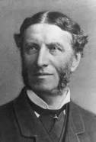
Discuss:
Put the first sentence into your own words. How does the sentence’s complexity add to its impact?
Where are the most important words in the second sentence of this passage—at the beginning or at the end? What effect does this have on the reader?

Slide 163
Response
1. Students’ sentences should be something like this: “Culture helps us, because of its high standards, to fully understand and accept the fact that wealth is an unworthy goal.” The complexity of Arnold’s sentence intensifies the tone of seriousness, alerting readers to the highly formal language of the passage.

Slide 164
Response
2. The words that complete the meaning of the second sentence (the future as well as the present would eventually belong to the Philistines) are at the end of the sentence. Sentences that delay closure until the end (the period) of the sentence are called periodic sentences. Periodic sentences carry high tension and interest: the reader must wait until the end of the sentence to understand the meaning of the sentence. Periodic sentences are used frequently in formal prose and are often very complex. This sentence withholds syntactic closure, increasing the tension of the sentence and keeping the reader’s attention until the meaning is fully disclosed at the end of the sentence.

Slide 165
Syntax #7
Consider:
I slowed still more, my shadow pacing me, dragging its head through the weeds that hid the fence.
--William Faulkner, The Sound and the Fury

Slide 166
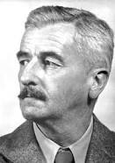
Discuss:
In this sentence, form imitates meaning. How does Faulkner slow the sentence down, reinforcing the sentence’s meaning?
How would the impact of the sentence change if we rewrote the sentence to read:
  I slowed still more. My shadow paced me and dragged its head through the weed-obscured fence.

Slide 167
Response
1. Faulkner slows the sentence down by layering participial phrases (pacing me, dragging its head) that modify shadow. This technique slows the reader down, echoing the meaning of the sentence itself.
2. The rewritten sentence lacks the power of Faulkner’s. The pace of the words no longer matches the meaning, and the reader’s attention is distracted by the abrupt shift from the I of the sentence to the shadow.

Slide 168
Syntax #8
Consider:
The graces of writing and conversation are of different kinds, and though he who excels in one might have been with opportunities and application equally successful in the other, yet as many please by extemporary talk, though utterly unacquainted with the more accurate method and more laboured beauties which composition requires; so it is very possible that men, wholly accustomed to works of study, may be without that readiness of conception and affluence of language, always necessary to colloquial entertainment.
Sam Johnson, “An Author’s Writing and Conversation Contrasted”

Slide 169
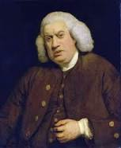
Discuss:
The main idea of this sentence is stated in the first ten words. What purpose does the rest of the sentence serve?
What is the purpose of the semicolon? How does the use of a semicolon reinforce the meaning of this sentence?

Slide 170
Response
The rest of the sentence extends and exemplifies the main idea of the sentence.
The semicolon balances independent clauses of equal weight. Here, it gives equal consideration but falls short in written composition and another who excels in written composition but falls short in lively conversation.

Slide 171
Syntax #9
Consider:
There is another and curious class of cases in which close external resemblance does not depend on adaptation to similar habits of life, but has been gained for the sake of protection. I allude to the wonderful manner in which certain butterflies imitate…other and quite distinct species….The mockers and mocked always inhabit the same region; we never find an imitator living remote from the form which it imitates. The mockers are almost invariably rare insects; the mocked in almost every case abound in swarms.
--Charles Darwin, “Analogical Resemblances,” The Origin of Species

Slide 172
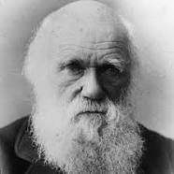
Discuss:
Why does Darwin use a semicolon rather than a period in the last sentences of this passage?
What effect does the sentence structure have on the meaning of the passage?

Slide 173
Response
The independent clauses in each of these sentences contain closely connected ideas and are thus best joined by a semicolon. A period would be too strong a separation. The independent clauses are of equal weight, and the clauses amplify and complement each other.
The sentences are balanced and orderly, reflecting the logical development of the passage. In addition, the sentence structure helps the reader see connections. The parallel structure of the last two sentences adds to the coherence of the passage, which reflects the cohesiveness of his thinking.

Slide 174
Syntax #10
Consider:
“I’m clean, Carlito, I’m not using.” My voice dropped to a whisper. “I’m not using.” And oh, God, I found my mind, thinking. Wonder what it would be like again? Wonder what it would be like again? Wonder…
--Piri Thomas, Down These Mean Streets

Slide 175
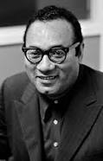
Discuss:
Thomas repeats the question Wonder what it would be like again? three times in the passage. What effect does this repetition have on the impact of the passage?
At the end of the passage, Thomas uses ellipses to indicate an omission of words required for complete syntactical construction but unnecessary for understanding. What words are missing? What impact does this omission have on the passage?

Slide 176
Response
The repetition of the question emphasizes this thought process and re-creates his obsession with trying drugs again. Balanced with the repeated I’m clean…I’m not using…I’m not using, it reflects the struggle between his pride in being drug free and his desire to use the drug again. The movement of the sentence, however, leans toward trying the drug again. Repetition with no variation in syntax increases the importance of the repeated clause and parallels the narrator’s growing concern.
The missing words are what it would be like again. The omission emphasizes the narrator’s growing concern with what it would be like to try drugs again. The ellipses leave the paragraph open, which implies that the question could be asked yet again, reinforcing the emphasis on the narrator’s struggle.

